Slide 1
DATA EXTRACTION AND VISUALISATION USING VEGALITE
Presented by: Meenakshi Kanungo
B.Sc. Economics, Semester-III
Loreto College

Slide 2
INTRODUCTION
This project focuses on extracting data from Power BI report file and presenting it through clear, interactive visualisations using Vegalite. The goal of this project is to combine the data processing strength of Power BI with the flexibility of Vegalite to present meaningful and interactive visual insights.

Slide 3
DATA CLEANING AND EXTRACTION PROCESS
Data Cleaning
Extracting Raw Dataset
Visualising Insights

Slide 4
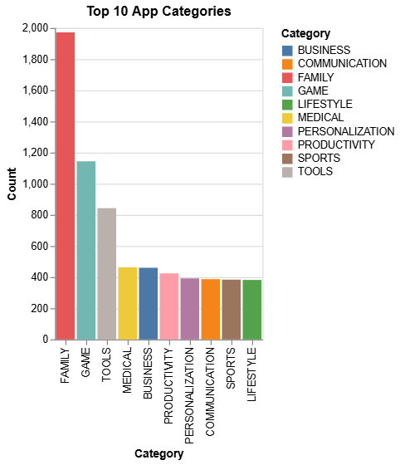
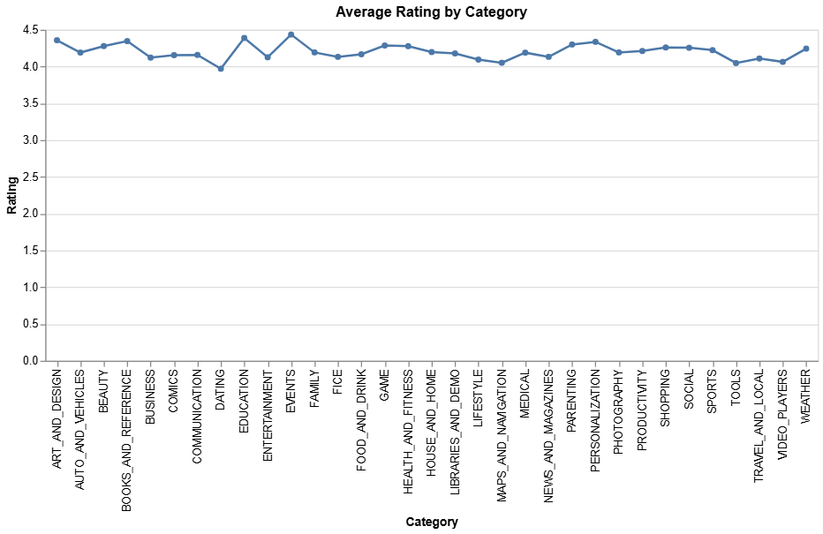
VEGALITE CHARTS VISUALISATIONS
#Line Chart: Average Rating by Category
df = pd.read_csv('Cleaned Dataset.csv')
avg_rating = df.groupby('Category', as_index=False)['Rating'].mean()
alt.Chart(avg_rating).mark_line(point=True).encode(
x='Category:N',
y='Rating:Q',
tooltip=['Category', 'Rating']
).properties(
width=700,
title='Average Rating by Category'
)
# Bar Chart: Top Categories
category_counts = df['Category'].value_counts().reset_index()
category_counts.columns = ['Category', 'Count']
alt.Chart(category_counts.head(10)).mark_bar().encode(
x=alt.X('Category:N', sort='-y'),
y='Count:Q',
color='Category:N',
tooltip=['Category', 'Count']
).properties(title='Top 10 App Categories')

Slide 5
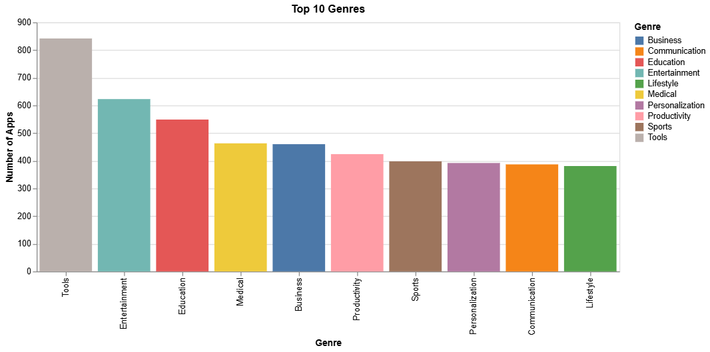
genre_counts = df['Genres'].value_counts().head(10).reset_index()
genre_counts.columns = ['Genre','Count']
#Bar Chart: Top 10 Genres
alt.Chart(genre_counts).mark_bar().encode(
x=alt.X('Genre:N', sort='-y', title='Genre'),
y=alt.Y('Count:Q', title='Number of Apps'),
color='Genre:N',
tooltip=['Genre', 'Count']
).properties(
width=700,
title='Top 10 Genres'
)

Slide 6
KEY LEARNINGS FROM THE PROJECT
Working with Complex File Structures
Data Cleaning and Preparation
Data Visualisation Principles

Slide 7
REFERENCES
https://docs.streamlit.io/develop/api-reference/charts/st.vega_lite_chart
https://altair-viz.github.io/user_guide/data.html
https://vega.github.io/vega-lite/examples/#repeat--concatenation
https://docs.streamlit.io/develop/api-reference/charts/st.vega_lite_chart
https://www.kaggle.com/code/faisaljanjua0555/eda-google-play-store-apps/input

Slide 8
THANK YOU!

